Slide 1
Securing the Kansas Criminal Justice Information System
Norma Jean Schaefer, KBI
Notes:
Hello story about being hired at the KBI

Slide 2
Presentation
KCJIS Objectives
KCJIS Components
Security Objectives/Policies
Security Components
Where are we today?

Slide 3
KCJIS Objectives

Slide 4
KCJIS Agencies
  Kansas Attorney General
  Kansas Bureau of Investigation
  Kansas Highway Patrol
  Local law enforcement agencies, courts, prosecutors
  Kansas Department of Corrections
  Juvenile Justice Authority
  Office of Judicial Authority
  Department of Revenue

Slide 5
KCJIS Project Objectives
Open system architecture
Redundant hardware
Sharing of electronic data
Use Internet
Spawn unsolicited E-mail messages

Slide 6
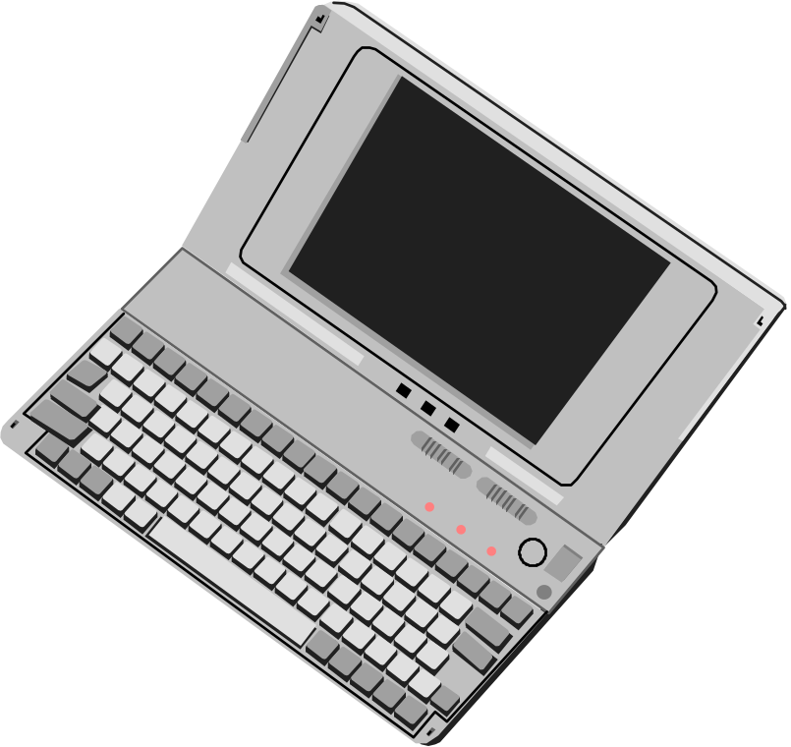

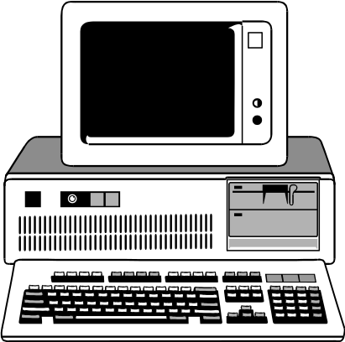
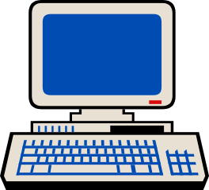
KCJIS Components

Slide 7
Current Message Switch
Message Switch
  Tandem switch.
  Not Y2K compliant.
  SNA 4.8K dedicated network.
  Not image capable
  Accesses NCIC, NLETS, KDOR, and MDOR

Slide 8
Current KCJIS Repository
Criminal Repository
  IBM AS400
  Adult and Juvenile records entered manually
  Inquiries and responses are paper-based
  resides at KBI
KIBRS
  Dbase program
  Manual entry by KBI staff

Slide 9
New KCJIS Components
Notes:
hELLO

Slide 10

NCIC
NLETS
Message
Switch
KBI LAN
KBI Firewalls
R

Slide 11
ASTRA Switch
Redundant Dell Servers
NT Enterprise - Clustering
Capable of sending data and images
Accesses NCIC, NLETS, KDOR, and MDOR
Certified KCJIS users only

Slide 12
NCIC
NLETS
Criminal Repository
Message Switch
KBI LAN
KBI Firewalls
R

Slide 13
KCJIS Criminal Repository
Microsoft SQL Server.
Capable of storing data and images.
Upload criminal history and KIBRS data electronically.
Query repository through the message switch or web server.
Archives all Message Switch transactions.

Slide 14
NCIC
NLETS
Criminal Repository
KCJIS Web Site
Message Switch
KBI LAN
KBI Firewalls
R

Slide 15
KCJIS Web Server
Microsoft Internet Information Server
Access information on the Criminal Repository and/or Message Switch using a web browser.
KCJIS project information.
KCJIS users only.

Slide 16
NCIC
NLETS
Criminal Repository
KCJIS Web Site
Message
Switch
KBI LAN
KBI Firewalls
KCJIS Public Web
DISC Firewall
R

Slide 17
KCJIS Pub Server
Microsoft Internet Information Server
Public information replicated from Criminal Repository.
  i.e. Conviction data
Public Access
Fee-based

Slide 18
NCIC
NLETS
Criminal Repository
KCJIS Web Site
Message Switch
KBI LAN
KBI Firewalls
KCJIS Public Web
KCJIS Email
DISC Firewall
R

Slide 19
KCJIS Email Server
Microsoft Exchange Server
Available to Small KCJIS agencies who would not have access to an E-mail account.

Slide 20
AFIS
New in 1998.
NT and Unix based system.
12 remote livescan units spread throughout the state.
Inquires and entries sent to state AFIS system in lights out mode.
Submit inquiries and entries to the FBI electronically.

Slide 21
How are we going to move all this data, images and video?
Internet
The decision to use the Internet was the vision of MTG Management Consultants.

Slide 22
Why choose the Internet?
Provides a flexible cost-effective alternative to private, dedicated leased lines for long distance data and image transfer.
  Estimated Cost Avoidance
    $1.5 million to state
    $1 million to users
We can now share images and video.

Slide 23
Why do we need security?
Moved from a more secure, dedicated SNA network to a TCP/IP based network.
KBI LAN has a direct connect to the Internet.
Open system architecture.
Sensitive data.

Slide 24

KCJIS Customers
Small agencies with no (Local Area Network) LAN
Medium to Large agencies with a LAN made up of KCJIS and non-KCJIS users.
Metropolitan Area Networks (MAN)
Mobile Data Terminals
Dial-up users

Slide 25
KCJIS Networks
Users can sit on 1 of 3 Kansas frame relay networks, or their own public ISP.
State of Kansas leases circuits and manages routers on these 3 networks.
Two new frame relay clouds were created for KCJIS.

Slide 26
NCIC
NLETS
Criminal Repository
KCJIS Web Site
Switch
KBI LAN
KBI Firewalls
KCJIS Public Web
KCJIS Email
DISC Firewall
R
Secure KCJIS

Slide 27
Secure KCJIS
Secure KCJIS
A frame relay network made up of:
  KCJIS only users
  Router-based network
  Typically 56K, 128K, and 384K
  Firewall type device required.
  Protected by an additional firewall that is owned and managed by DISC.
  All traffic in and out must pass through the DISC firewall.

Slide 28
NCIC
NLETS
Criminal Repository
KCJIS Web Site
Message Switch
KBI LAN
KBI Firewalls
KCJIS Public Web
KCJIS Email
DISC Firewall
R
Open KCJIS
Secure KCJIS

Slide 29
Open KCJIS
Open KCJIS
A frame relay network made up of:
  KCJIS and non-KCJIS users on the same LAN, MAN, or WAN
  56K, 128K, 384K and T1
  Firewall required between LAN and connection to the internet.
  Traffic not mixed with other state agencies and higher education.
  This network created for availability, not security.

Slide 30
Management of Secure and Open CJIS Network
  KCJIS will have a SLA with DISC
  Some items in the SLA:
    Availability of the network.
    Monitoring and logging all traffic entering the Secure CJIS cloud.
    Manage all routers securely

Slide 31
NCIC
NLETS
Criminal Repository
KCJIS Web Site
Message
Switch
KBI LAN
KBI Firewalls
KCJIS Public Web
KCJIS Email
Internet
DISC Firewall
R
KANWIN/
Internet
Open KCJIS
Secure KCJIS

Slide 32
KANWIN (Kansas Wide
Area Network)
KANWIN/
Internet
A frame relay network made up of:
  56K, 128K, 384K and T1
  State and local government, K-12 and higher education, medical, and videoconferencing
  Dial-up
  Connection to Internet for all frame relay clouds.
  Firewall required between LAN and connection to the internet.

Slide 33
Security Objectives and Policies

Slide 34
What are our security objectives?
Protect all devices and data on KBI LAN.
Identify the specific user of KCJIS.
Identify the specific device.
Protect data transmissions over a public carrier.
Monitor for intrusion.
Analyze network vulnerability.

Slide 35
Security Policies
Reviewed NCIC, NLETS, State regulation and policies, and ASTRA Board policy.
  Internet use was not allowed by any national networks.
KBI began purchase process and implementation before we had current policies.

Slide 36
Security Policies
Kansas policies were approved by the ASTRA Board in August 1998.
  Addressed network, authentication, encryption, physical security, auditing, and training.

Slide 37
Who installed system?
FishNet Consulting, Inc. Kansas City, MO
Close to Topeka, KS
Capable of installing, selling and supporting all products used in security system.
Engineers certified in KCJIS components.
24/7 and 3-years maintenance agreement.

Slide 38
Security Components
“Best of Breed”
and
OPSEC Partners

Slide 39
NCIC
NLETS
Criminal Repository
CJIS Web Site
Switch
KBI LAN
CJIS Public Web
CJIS Email
KBI Firewalls
DISC Firewall
R
KANWIN/
Internet
Open CJIS
Secure CJIS

Slide 40
CheckPoint’s Firewall-1
Protects devices and data on KBI LAN.
Firewall-1 (v 4.0) Enterprise Software
Control In and Out-bound traffic and used to create VPN.
Redundant Sun Ultra-5 Unix boxes
StoneBeat - Software for high availability
Chrysalis-ITS encryption NICs
Notes:
Stonebeat
The primary and secondary firewalls are identical with respect to hardware configuration and FireWall-1 software. If the primary firewall fails, it activates a switch over procedure. If failure occurs the secondary firewall will reconfigure its network interfaces by using exactly the same IP and MAC addresses as the primary firewall. All connections are preserved, the user will see a short delay.
Chrysalis cards
The cards are capable of T1 to fast Ethernet connections and integrates with Check Point firewall-1 VPN solution. The cards offload encryption from the CPU of the firewall to the NIC card. The cards accelerate the cryptographic functions of the standard IPSec using ISAKMP/Oakley key management.

Slide 41
NCIC
NLETS
Criminal Repository
CJIS Web Site
Ace/Slave
SecurID
Message Switch
KBI LAN
KBI Firewalls
CJIS Public Web
CJIS Email
DISC Firewall
R
KANWIN/
Internet
Open CJIS
Secure CJIS

Slide 42
Security Dynamics - SecurID*
Strong user authentication.
Two factor authentication. Something you know (PIN) and something you have (Token).
Generates unpredictable, one-time-only access codes that change every 60 seconds.
High-availability configuration.
Used to authenticate to each KCJIS server.
Notes:
Unloaded a lot of administration. We are expected to grow to 12,000 users and if we had to manage passwords for 12,000 users this could have been a nightmare.

Slide 43
Security Dynamics - SecurID
All KCJIS users will require token.
Grow to 12,000 users.
Lower administration.
4,000 tokens purchased by the state.

Slide 44
NCIC
NLETS
CA
Backup
Ace/Slave
SecurID
Criminal Repository
CJIS Web Site
Certificate
Authority
Message
Switch
KBI LAN
KBI Firewalls
CJIS Public Web
CJIS Email
DISC Firewall
R
KANWIN/
Internet
Open CJIS
Secure CJIS

Slide 45

Entrust Technologies, Inc.
KCJIS is its own Certificate Authority.
Utilize encryption and digital signature keys.
Identifies the device used in transaction.
Provides access control.
Data integrity and Non-repudiation
Certificate and keys are deployed electronically upon first time connection to KCJIS.
State purchased 2,500 certificates.
Notes:
Encrypt Data
Digitally signs the file with the users private key. This is the hash value signed with users private signing key. The users signing public key, which is certified for integrity by the Certification Authority, is included with the file to allow the other party to verify the signature.
Entrust generates a random, one-time-use symmetric key and uses it to encrypt the file.
Encrypt Data Part II
Takes firewall public key and encrypts symmertric key that was used to encrypt the file.
Decrypt Data
Firewall decrypts the encrypted symmetric key, using the firewall’s decryption private key.
Firewall uses symmetric key and decrypts the encrypted file.
Firewall takes the senders public key, used to sign the file, verifies its validity and uses it to verify the signature.
If the protected file has not been changed since it was signed and encrypted, the signature is accepted.

Slide 46
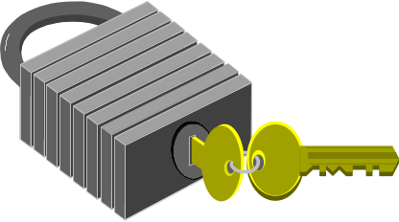
Checkpoint - SecuRemote
Client-side encryption software.
Creates a Virtual Private Network (VPN).
Encrypts ALL data from the desktop to the KBI firewall.
Using Triple DES encryption and ISAKMP.
Free for desktops.
Notes:
IPSec is the first security standard to be designed with multi-vendor
interoperability in mind. IPSec’s flexible key management scheme, the
Internet Security Association Key Management Protocol (ISAKMP), allows
two parties to quickly and dynamically agree on a security association
(keys, encryption and authentication algorithms and other parameters for
the connection) before any communications takes place.

Slide 47
NCIC
NLETS
CA
LDAP
Backup
Criminal Repository
CJIS Web Site
Certificate
Authority
Ace/Slave
SecurID
LDAP
Switch
KBI LAN
KBI Firewalls
CJIS Public Web
CJIS Email
RealSecure
DISC Firewall
R
KANWIN/
Internet
Open CJIS
Secure CJIS

Slide 48
Netscape’s LDAP Directory
A single directory server that can search and manage millions of users entries at a time.
Stores user, group data, access control lists, X.509v3 certificates and client profiles.
Eliminates the need to enter user data in multiple servers.
Industry standard LDAP Protocol.

Slide 49
NCIC
NLETS
LDAP
CA
LDAP
Backup
Criminal Repository
CJIS Web Site
Certificate
Authority
Ace/Slave
SecurID
Switch
KBI LAN
KBI Firewalls
CJIS Public Web
CJIS Email
RealSecure
DISC Firewall
R
KANWIN/
Internet
Open CJIS
Secure CJIS

Slide 50

Internet Security Systems
RealSecure
  Automated, real-time intrusion detection and response system.
  Interprets hostile activity by recognizing attack traffic patterns and alerts KBI administrator.
  Attack can be logged, recorded for later playback and/or terminated automatically.
  Can dynamically reconfigure firewall based on security policy.

Slide 51
Internet Security Systems
Internet Scanner
  Allows KBI administrators to proactively seek out internal system vulnerabilities.
  Identifies and reports exploitable system weaknesses.
  This includes these and much more:
    password weaknesses;
    operating system configuration;
    file permissions.

Slide 52
How often will the security system be assessed?
Internal and external assessments will be quarterly by Fishnet Consulting, Inc.
  Fishnet Consulting, Inc. employees will have to have passed a background investigation, and a national fingerprint check.
KBI assessment will be on-going.

Slide 53

What additional security?
Controlled access to building.
Controlled access to computer lab.
Communications Unit available 24/7.
UPS system/Diesel generator
Redundant servers.
Trained KBI staff. (Acceptable Use Policies)

Slide 54
My Wish List
Load balancing and traffic priority
Additional staff to operate
Additional reporting tools

Slide 55
What challenges did we face?
Funding
  State - security system
  Local - firewalls, tokens and certificates
Management
  Communication/notification to the users
    timely and cost effective
System administration
  Deployment
  Help desk
Notes:
Funding
At time of budgeting the security, we hadn’t looked at what it would take therefore we underbudgeted for security.
Management
Cost effective communication and timely
System Administration
We have had to add additional duties to staff to assist in deploying security. We had to add additional duties to the same people to make them a help desk.

Slide 56
Where are we today?
Message Switch began operation in October.
Approx. 93 of the 270 sites have access to the Message Switch.
Deployment of certificates is on-going.
Deployment of tokens is on-going.
KCJIS Web server in test.
Criminal Repository late Summer.

Slide 57
Where are we today?
National NCIC Security Policies are in place.
  The CJIS Advisory Policy Board approved CJIS Security Policy December 16-17, 1998 in Marina Del Rey, CA.

Slide 58
Where are we today?
The Kansas ASTRA Sub-committee updated security policies in February.
  Changed encryption and firewall requirements to adhere to NCIC policy.
Waiting for approval by the ASTRA Board.
At a minimum, policies need to be reviewed every 6 months.

Slide 59
NCIC
NLETS
LDAP
CA
LDAP
Backup
Criminal Repository
CJIS Web Site
Certificate
Authority
Ace/Slave
SecurID
Message
Switch
KBI LAN
KBI Firewalls
CJIS Public Web
CJIS
Email
RealSecure
DISC Firewall
R
KANWIN/
Internet
Open CJIS
Secure CJIS

Slide 60
You can not have
‘security through obscurity.’
-Jody Brazil, FishNet Consulting, Inc.

Slide 61
Conclusion
Are we secure today?
Will we be secure tomorrow?
Is using the Internet worth the risk?

Slide 62
KBI Security Philosophy
“A good security plan will address security objectives and policies. Our mind set is that we really do not have a ‘security system,’ rather an on-going security plan and direction. Our ‘security system’ is simply where we are at any given moment.”
- Ron Rohrer, KBI

